Slide 1
IBM Applied Data Science Capstone Project
The Battle of Neighborhoods – Which Tokyo Ward(s) Should a Tourist Visit?

Slide 2
Contents
Introduction
Business Problem
Dataset
Methodology
Results
Discussion

Slide 3
Introduction
Tokyo had an 87% drop in number of tourists in 2020 due to Covid-19
Future travelers are limited in the areas to explore
Need an efficient travel plan to enjoy the most number of experiences in the shortest time

Slide 4
Business Problem
Which Ward(s) should the future traveler explore so that they can have the most experiences in the shortest amount of time?

Slide 5
Dataset
Used BeautifulSoup to scrape https://en.wikipedia.org/wiki/Special_wards_of_Tokyo
Used Python’s geopy package obtain the latitude and longitude of all the major districts in the Wards of Tokyo
Merged the two data

Slide 6
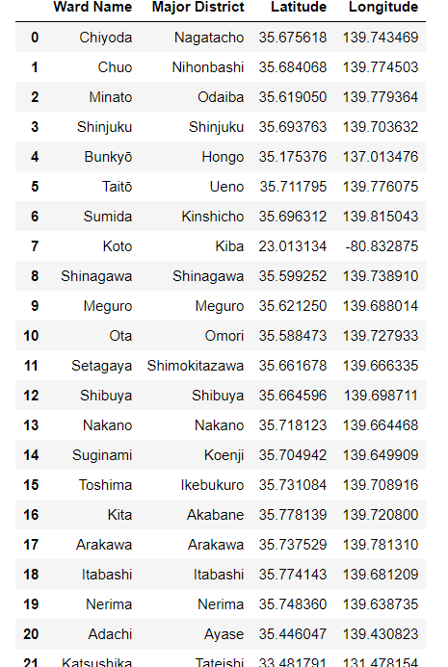
Dataset

Slide 7
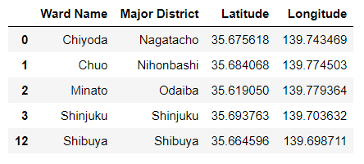
Methodology
Focused on only the 5 most popular Wards
Use Foursquare Place API to generate the top 100 most popular venues and their categories in each Ward across all major districts

Slide 8
Methodology
Only one major district from each Ward was scrapped- To explore all major districts in the same Ward, set the radius for Foursquare API to 5000 meters
Standardised the naming convention and convert all names to English

Slide 9
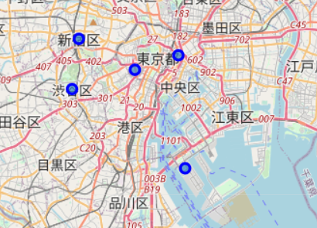
Methodology
Used the Folium library to create a map of Tokyo with the 5 Wards

Slide 10
Methodology
Used the Foursquare Place API to generate the top 100 most popular venues and their categories within a 5000m radius of each of the 5 Wards across all their major districts
Created a Pandas dataframe with one hot encoding for the venue categories
Grouped by ‘Major District’ and calculated their means
Results next slide

Slide 11
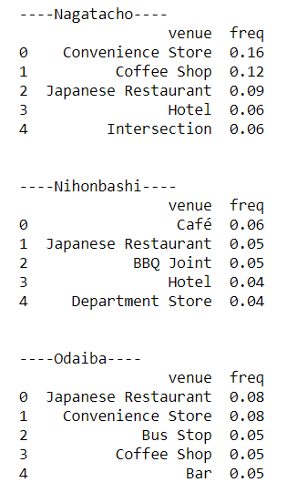
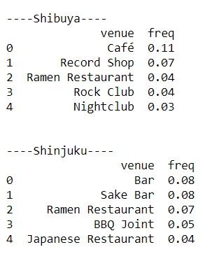
Methodology

Slide 12
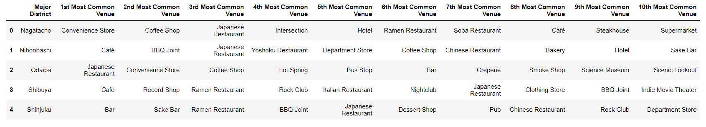
Methodology
Got the top 10 venue categories of each Ward:
Clustered the 5 Wards using dataframe above with the K-Means algorithm

Slide 13
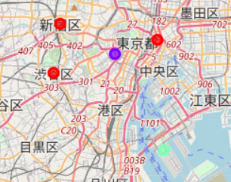
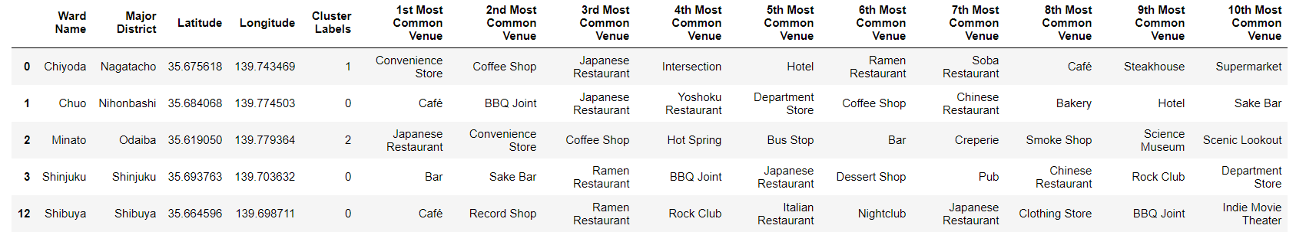
Results
Shibuya, Shinjuku, and Chuo were grouped in one cluster, while Minato and Chiyoda had their own clusters

Slide 14
Discussion
Chuo and Minato Wards should be visited by a traveler to maximise his experiences in the shortest period of time
Prices of these venues were not considered
Future studies should consider the population densities as well

